Slide 1


SANSKRITI JOURNEY

Slide 2
Presented By:
Name: Patel Panthi Ajaybhai
Enrolment No: 23002170210082
Roll No:9
Branch: IT
Div: C1

Slide 3
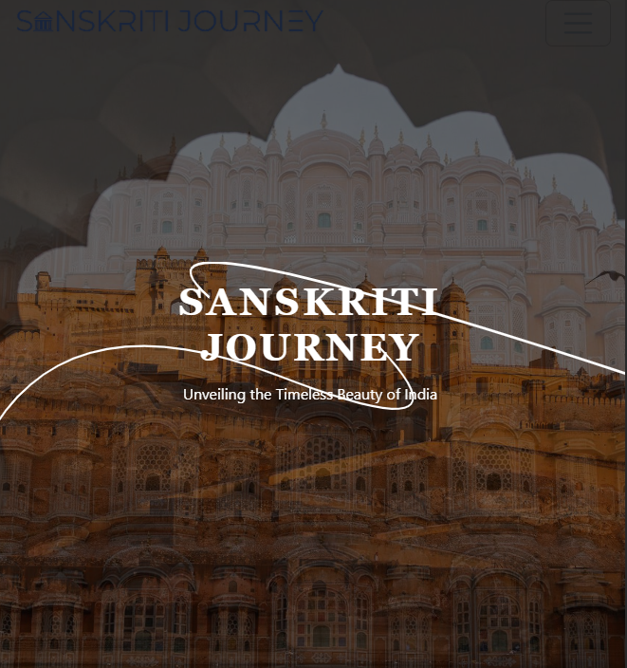
Introduction
Explore India's Heritage – An immersive platform showcasing rich culture through visuals, blogs, and interactive maps.
Smooth & Engaging Navigation – Experience seamless browsing with carousels, flip cards, and parallax effects.
Interactive Travel Guide – Discover states, cities, and attractions with an SVG-powered map and in-depth insights.

Slide 4
Home Page
Hero: Background video, typewriting, CTA button.
Modals: Welcome & Sign-In pop-ups.
About: Flip cards with landmarks.
Gallery: Carousel with hover text.
Testimonials: Auto-scrolling reviews.
Contact: Form & Google Map.
Back to Top: Scroll button.
JS Effects: Smooth animations.

Slide 5
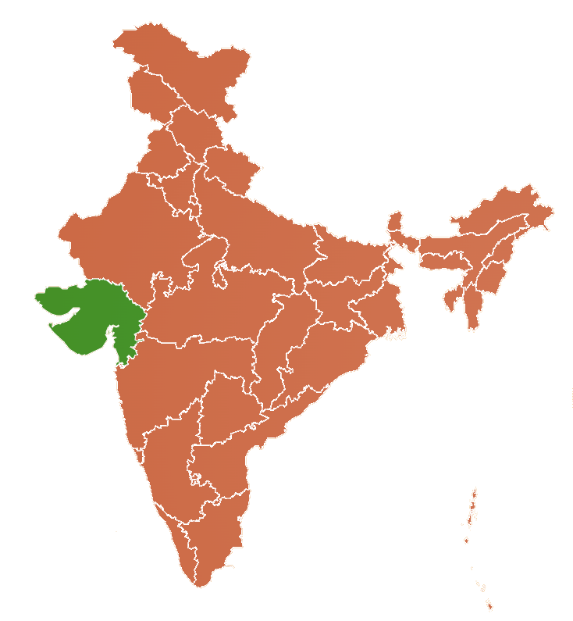
Start Your Exploration
Interactive India Map – Hover and select any state for details.
Exploring Gujarat – Zoom into regions like Ahmedabad.
Ahmedabad Heritage Tour – Browse landmarks with images, travel info, and nearby attractions.

Slide 6
Pros
Interactive UI
Smooth Navigation
Rich Content
Dynamic Features
Cons
No Personalization.
Limited Interactivity
Scalability Issues

Slide 7
Future Scope
User Accounts & Customization: Personalized itineraries and saved locations.
AI-Powered Recommendations: Suggest places based on user interests.
Augmented Reality (AR) Integration: Virtual tours for a more immersive experience.
Mobile App Expansion: A dedicated app for a seamless travel experience.

Slide 8
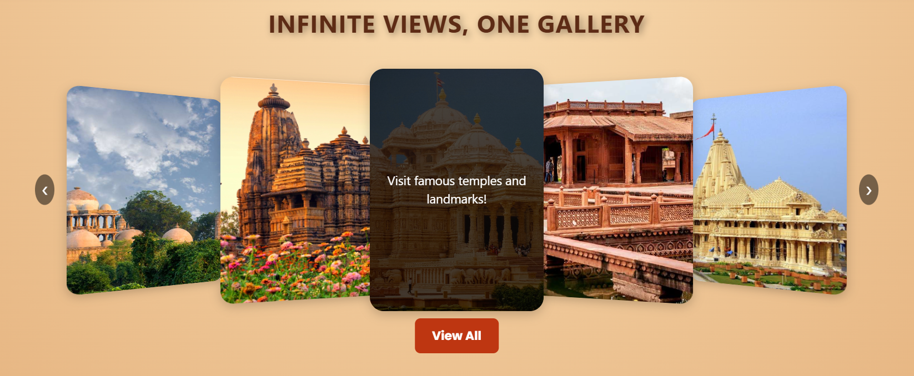
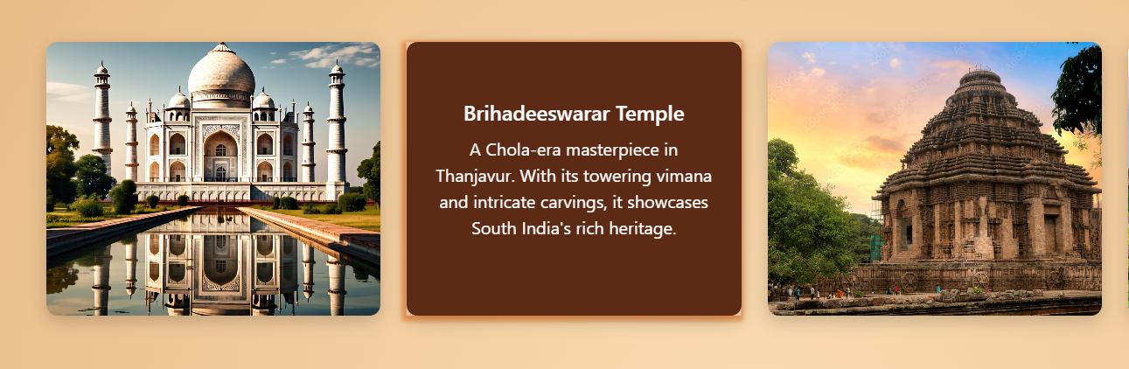
Timeless Treasures
Experience India’s architectural marvels, from the Taj Mahal to the Brihadeeswarar Temple, each telling a timeless story of culture and history.
Explore breathtaking landmarks in a stunning image carousel, bringing India’s rich heritage to life with every scroll.

Slide 9
Thank You

